Slide 1

Olympic Data Analysis: 120 years of the games
By: Andrea Colin, Matthew Sturt, Nick Johanson, and Elizabeth Christian

Slide 2

Dataset
120 years of Olympic history: athletes and results
All the Games from Athens 1896 to Rio 2016
Dataset was obtained from Kaggle
Variables included: ID, Name, Sex, Age, Height, Weight, Team, NOC, Games, Year, Season, City, Sport, Event, Medal

Slide 3
Questions/Areas of Analysis
Gender representation at games from 1970s – 2016
Relationship between age and medals won in Women’s Gymnastics
Major countries correlation of participation in sports
How average height affects country’s ability to medal for men’s and women’s basketball

Slide 4
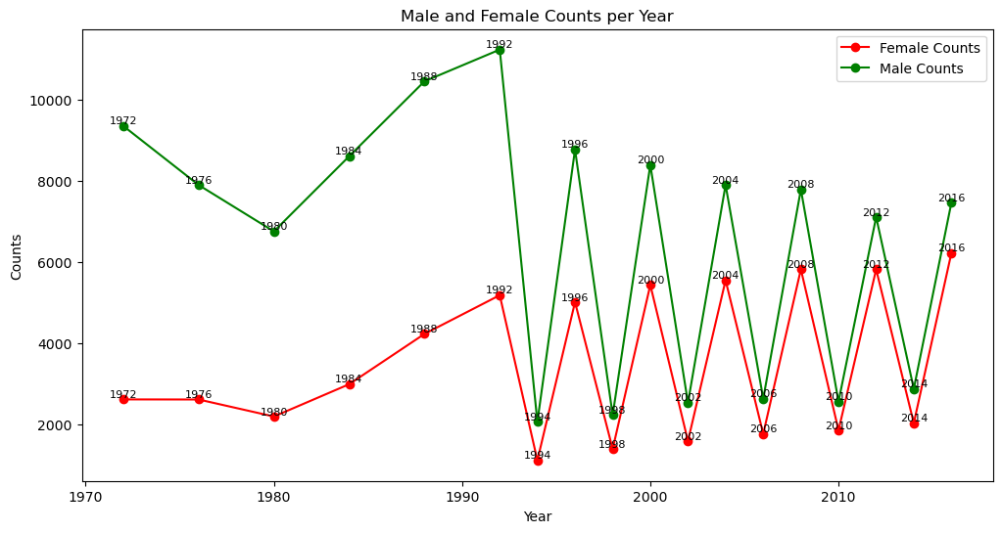
Gender ratios of athletes at Olympic games
Winter and Summer Games were held in the same year up until 1992

Slide 5
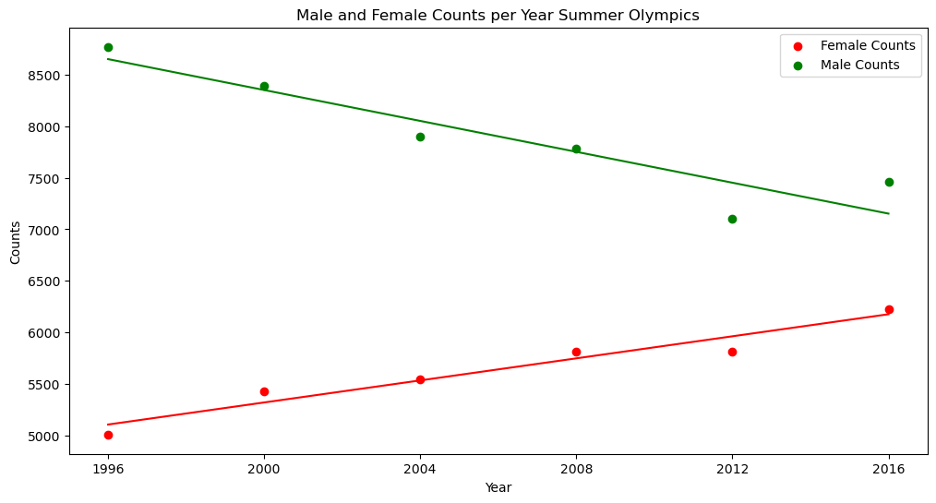
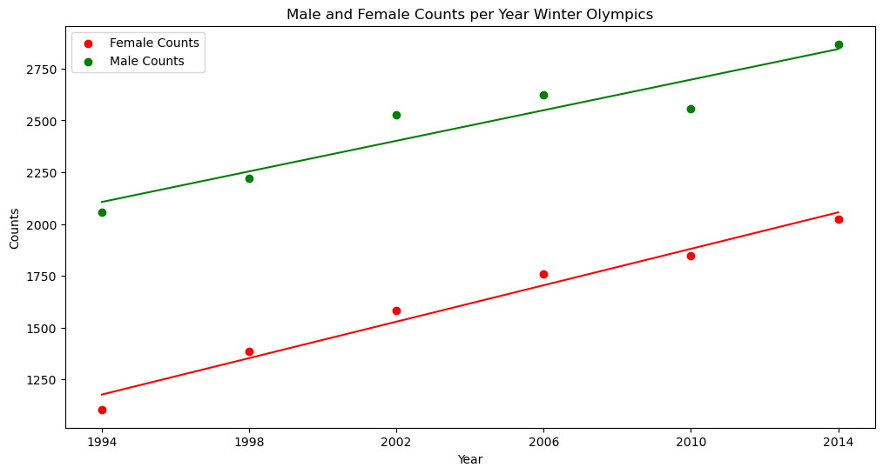


Separate the Summer and Winter Games with Gender Split

Slide 6
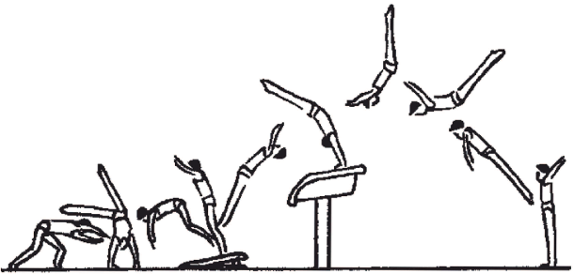
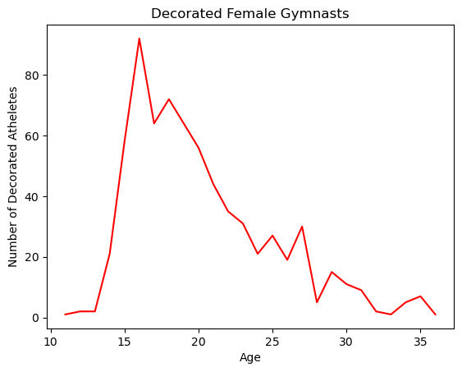

Age and Medalist Correlation in Women’s Gymnasts

Slide 7
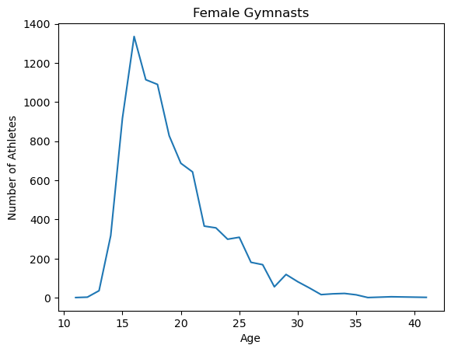
Age and Medalist Correlation in Women’s Gymnasts

Slide 8
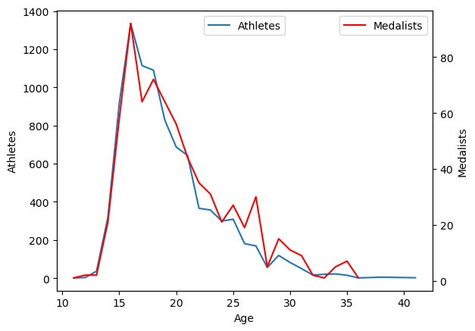
Age and Medalist Correlation in Women’s Gymnasts

Slide 9
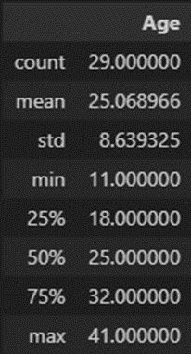
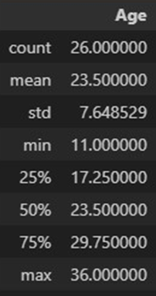
Age and Medalist Correlation in Women’s Gymnasts

Slide 10
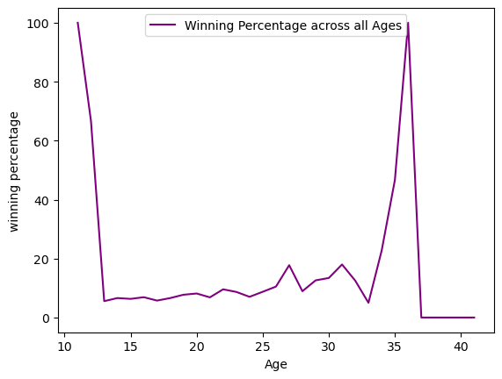
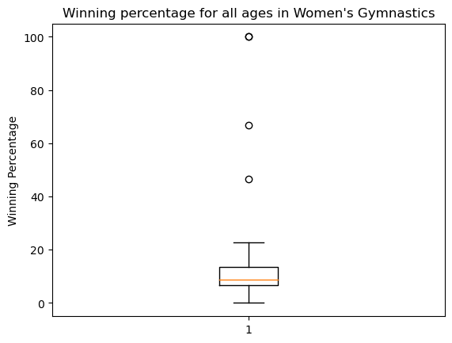
Age and Medalist Correlation in Women’s Gymnasts

Slide 11
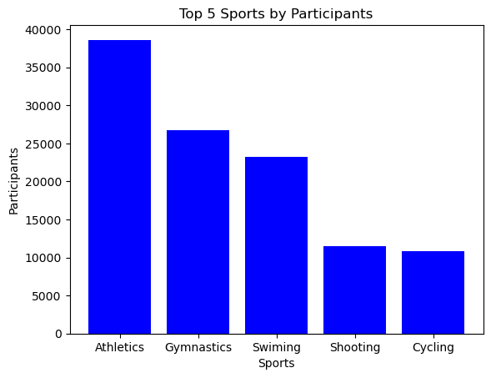
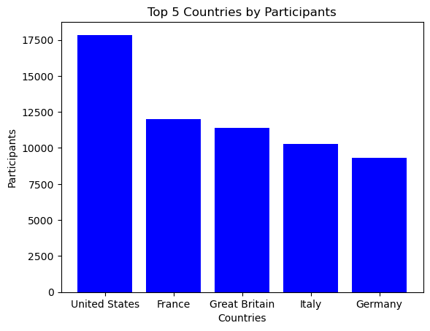
Olympic Games Overview

Slide 12
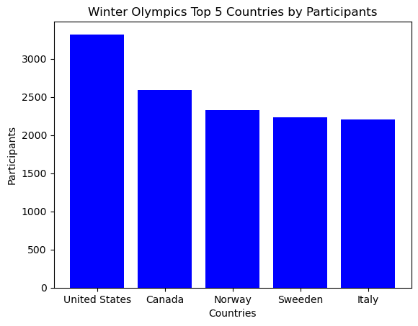
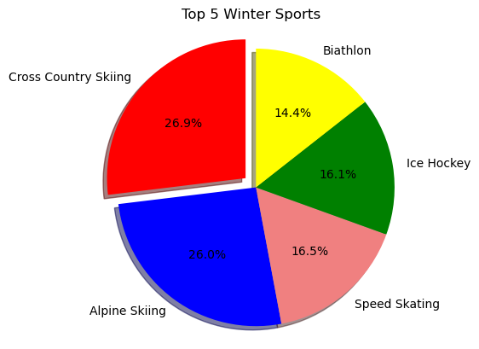
Winter Olympics

Slide 13
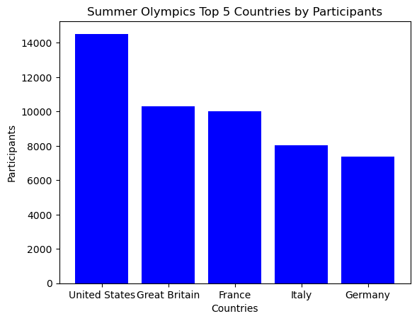
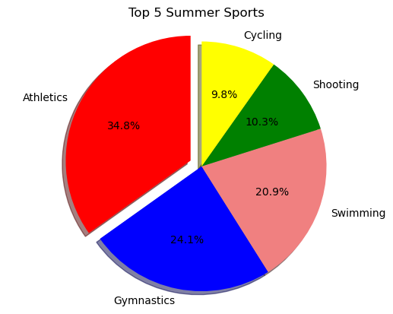
Summer Olympics

Slide 14
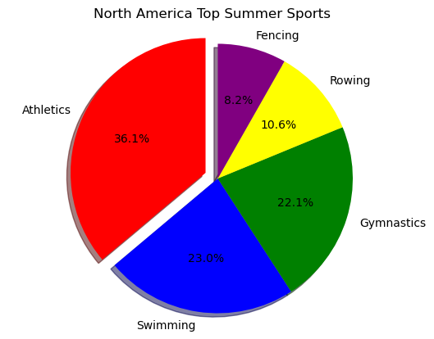
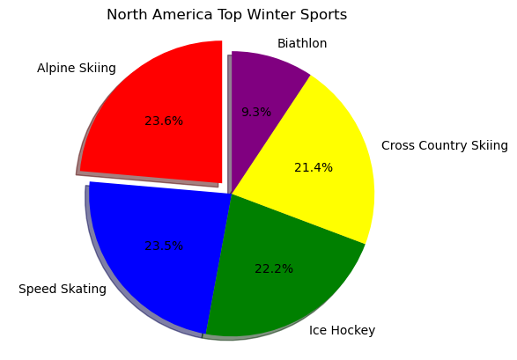
North America

Slide 15
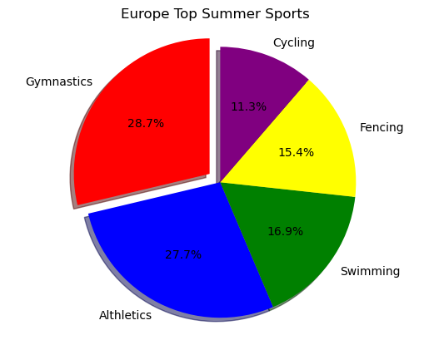
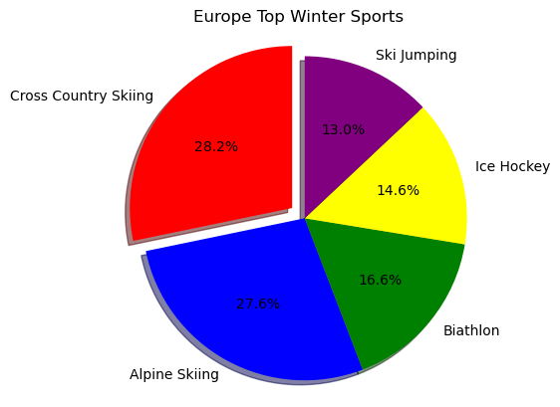
Europe

Slide 16
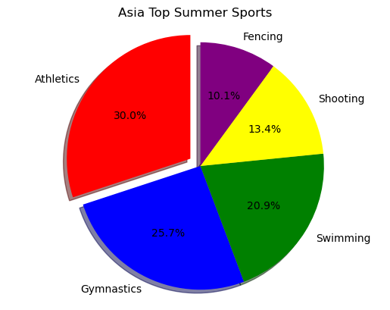
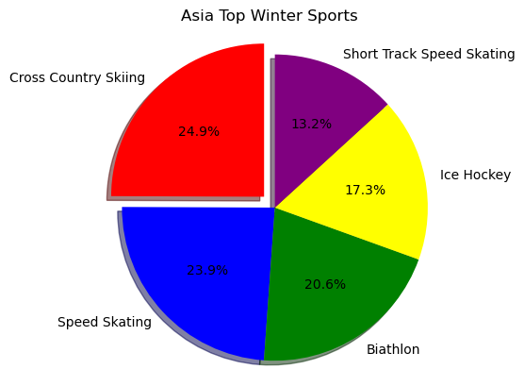
Asia

Slide 17
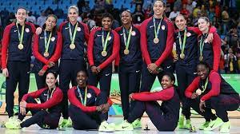
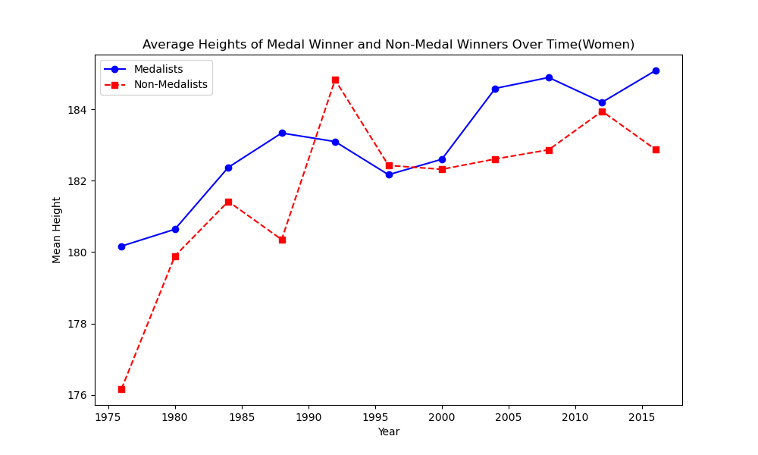

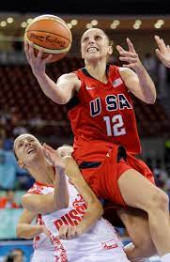
Average Height of Medalist vs Non-Medalist (Women)
T Test Result:
Statistic=1.2910745454235144,
P - value=0.19711525992599624

Slide 18
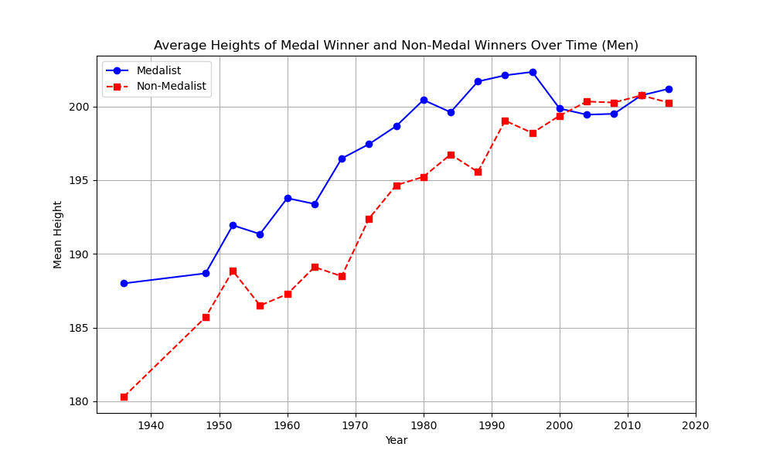
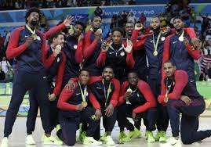
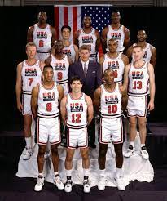
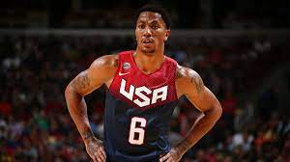
Average Height of Medalist vs Non-Medalist (Men)
T Test Result:
Statistic=7.283799718776104,
P - value=6.211224212140947e-13

Slide 19
Thank you!

Slide 20
Citations
120 years of Olympic history: athletes and results: https://www.kaggle.com/datasets/heesoo37/120-years-of-olympic-history-athletes-and-results

